Slide 1
Randomized Algorithms CS648
Lecture 9
Random Sampling
part-II :
Estimating a parameter

Slide 2
Overview of the Lecture
Randomized Framework for
Number of balls from a bag
Size of transitive closure of a directed graph
An Inspirational Problem from Continuous probability
estimation of a parameter
But before all this, a simple algorithm exercise ☺

Slide 3

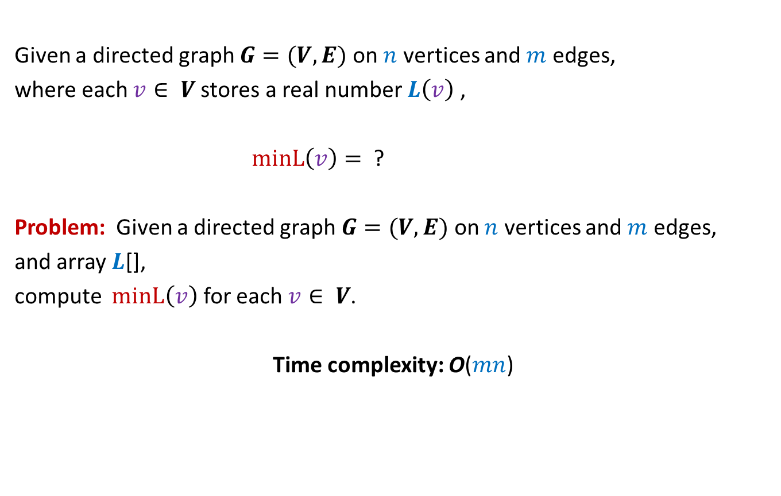

MIN-Label Problem
Given a directed graph $G=(V,E)$ on $n$ vertices and $m$ edges,
where each $v∈ V$stores a real number $L\left(v\right)$ ,
$minL\left(v\right)=$ ?
Problem: Given a directed graph $G=(V,E)$ on $n$ vertices and $m$ edges,
and array $L$[],
compute $minL\left(v\right)$ for each $v∈ V$.
Time complexity: O($mn$)
$$min\left\{L\left(x\right)\right| x \text{is} \text{reachable} \text{from} v\}$$
$$O(m+n\text{)}$$
The following two slides present two algorithms for this problem.
But, first make attempt on your own before studying these algorithms.

Slide 4

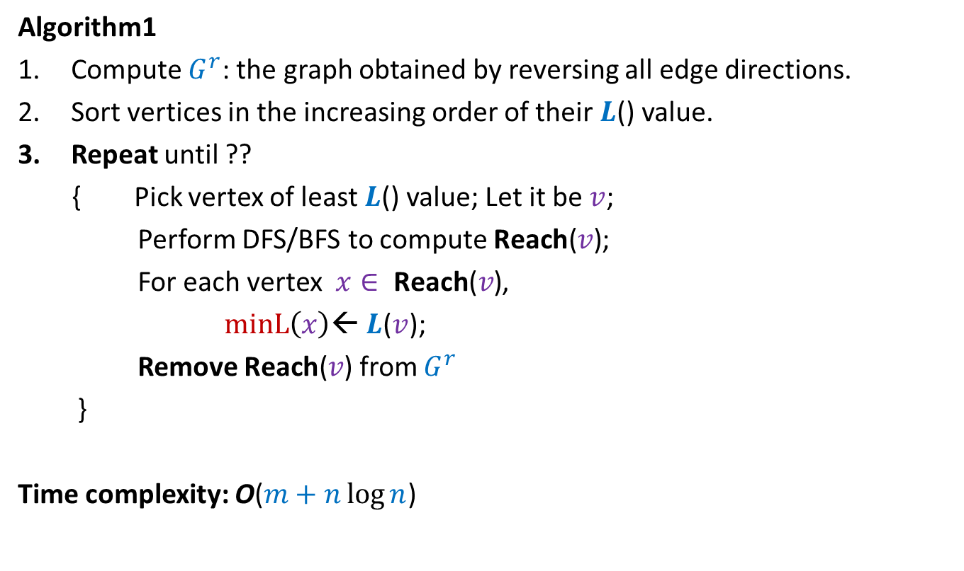
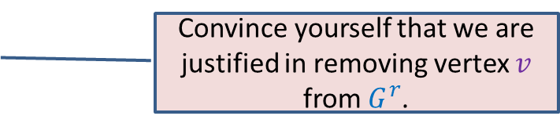
MIN-Label Problem
Algorithm1
Compute $G^{r}$: the graph obtained by reversing all edge directions.
Sort vertices in the increasing order of their $L$() value.
Repeat until ??
{ Pick vertex of least $L$() value; Let it be $v$;
Perform DFS/BFS to compute $\text{Reach}\text{(}v\text{)}$;
For each vertex $x∈ \text{Reach}\text{(}v\text{)}$,
$minL\left(x\right)$← $L$($v$);
Remove $\text{Reach}\text{(}v\text{)}$ from $G^{r}$
}
Time complexity: O($m+n\log{n}$)
$G^{r}$Is empty
Convince yourself that we are justified in removing vertex $v$ from $G^{r}$.

Slide 5
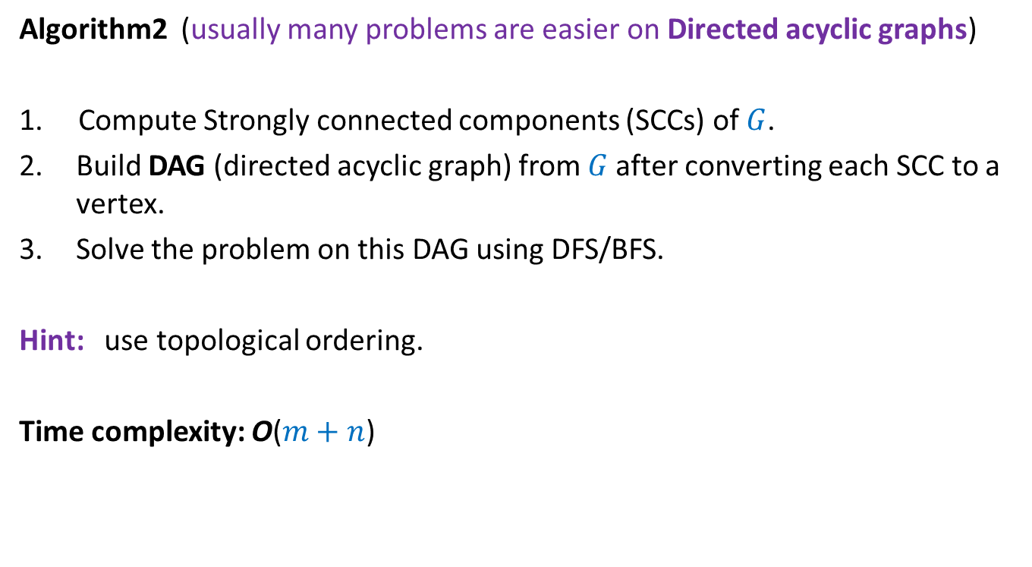
MIN-Label Problem
Algorithm2 (usually many problems are easier on Directed acyclic graphs)
1. Compute Strongly connected components (SCCs) of $G$.
Build DAG (directed acyclic graph) from $G$after converting each SCC to a vertex.
Solve the problem on this DAG using DFS/BFS.
Hint: use topological ordering.
Time complexity: O($m+n$)

Slide 6
An inspirational problem from continuous probability

Slide 7

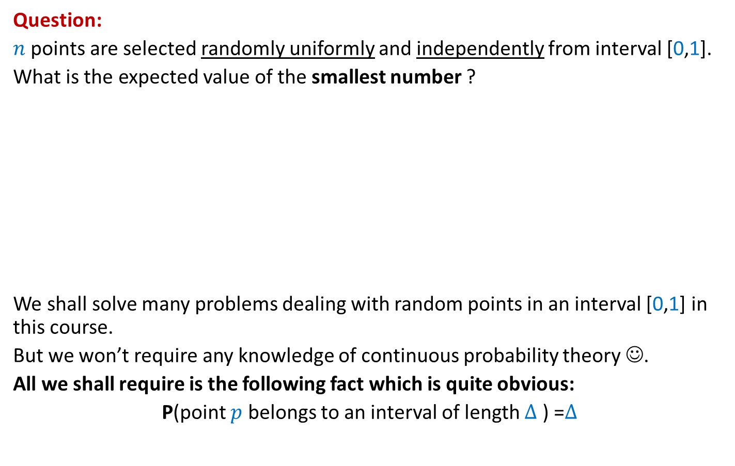



Question:
$n$ points are selected randomly uniformly and independently from interval [0,1].
What is the expected value of the smallest number ?
We shall solve many problems dealing with random points in an interval [0,1] in this course.
But we won’t require any knowledge of continuous probability theory ☺.
All we shall require is the following fact which is quite obvious:
P(point $p$ belongs to an interval of length $∆$ ) =$∆$
$$p$$
$$p$$
$$p$$
0
1
$$∆$$

Slide 8







Sampling points on a line segment
Question: What is E[$X_{i}]$ ?
Answer: It appears to depend upon $i$.
1
0
1
0
$$X_{n}$$
$$X_{n+1}$$
$$X_{1}$$
$$X_{2}$$
$$X_{3}$$
$$X_{4}$$

Slide 9











Sampling points on a Circle (of circumference 1)
$$X_{n}$$
Question: What is E[$X_{i}]$ ?
➔ E[$X_{1}$]=E[$X_{2}$]= … = E[$X_{n}$]
E[$X_{1}$+$X_{2}+…X_{n}$]= ??
➔ E[$X_{1}$]= ??
$$X_{1}$$
$$X_{n−1}$$
$$X_{2}$$
$$X_{3}$$
$$X_{4}$$
Prob. distribution of $X_{i}$
Prob. distribution of $X_{j}$
$$1$$
$$1/n$$

Slide 10


Alice
Bob
Bob is color-blind
(can’t distinguish between red and green color)

Slide 11
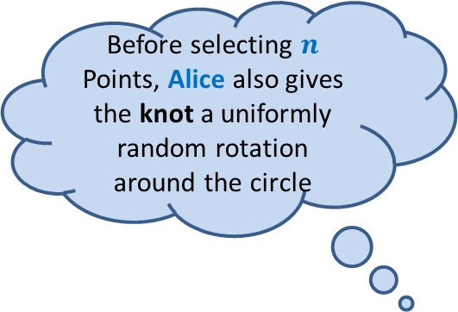
Transforming a line segment to a circle
Alice joins the ends of the line segment to form a knot so that it looks like circle.
Alice
Before selecting $n$
Points, Alice also gives the knot a uniformly random rotation around the circle

Slide 12



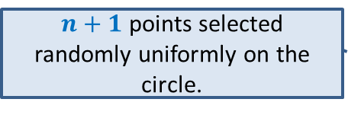
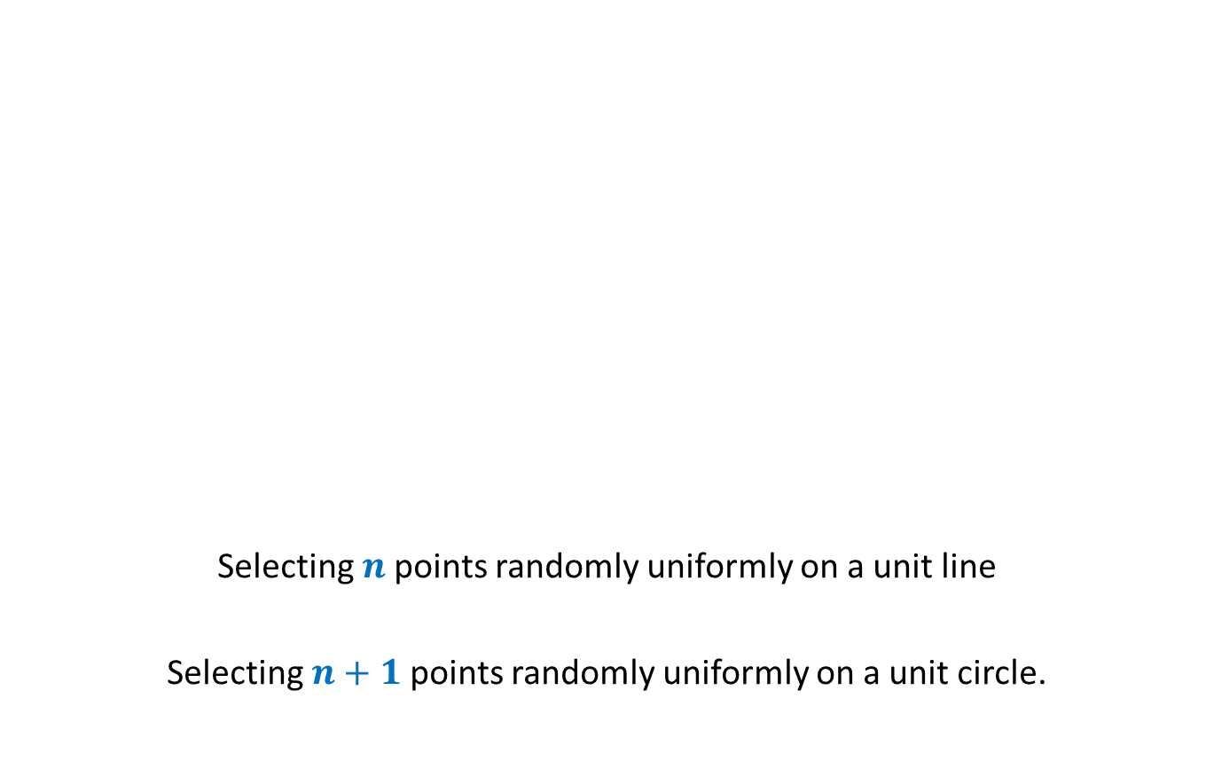



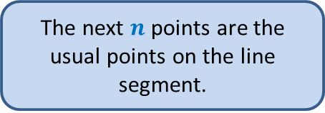
Transforming a line segment to a circle
Now Bob arrives
Alice
Selecting $n$points randomly uniformly on a unit line
Selecting $n+1$points randomly uniformly on a unit circle.
$$X_{n+1}$$
$$X_{n}$$
$$X_{1}$$
$$X_{2}$$
$$X_{3}$$
How will Bob perceive the entire experiment ?
$$X_{4}$$
First uniformly random point is the knot.
$n+1$ points selected randomly uniformly on the circle.
The next $n$ points are the usual points on the line segment.

Slide 13
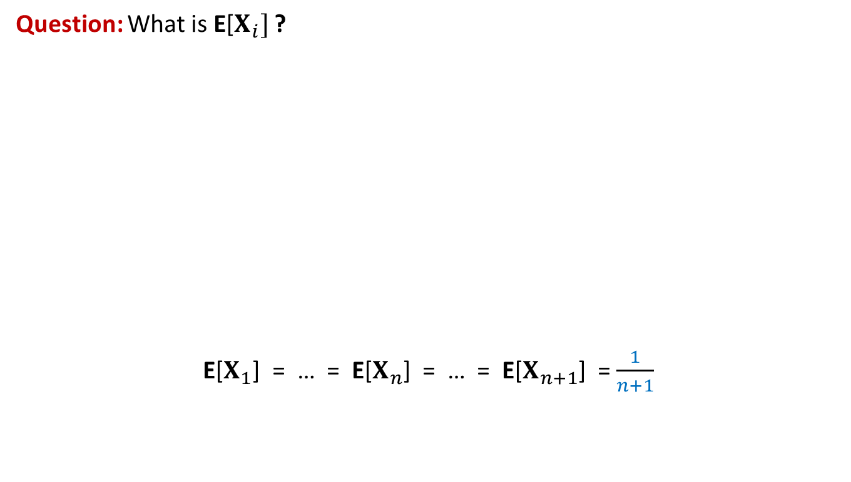
We have got the answer of the problem (without any knowledge of continuous probability theory)
Question: What is E[$X_{i}]$ ?
E[$X_{1}$] = … = E[$X_{n}$] = … = E[$X_{n+1}$] = $\frac{1}{n+1}$
0
1
1
0
$$X_{n}$$
$$X_{n+1}$$
$$X_{1}$$
$$X_{2}$$
$$X_{3}$$
$$X_{4}$$

Slide 14
Problem 1
Estimating
the number of Balls in a BAG

Slide 15

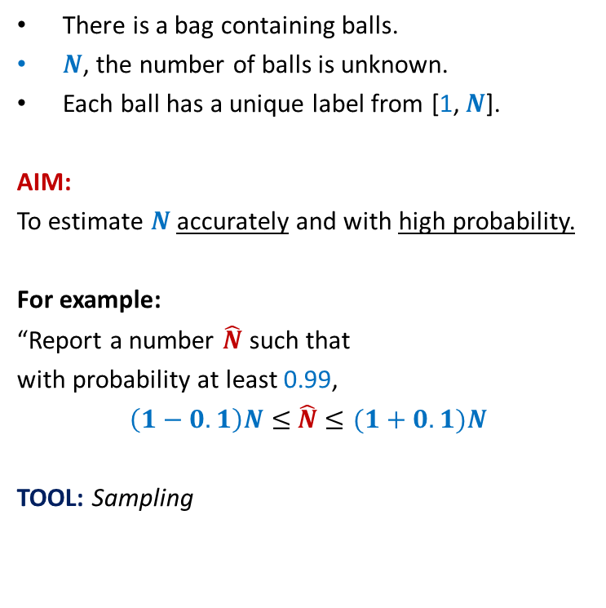
Estimating the number of Balls in a BAG
There is a bag containing balls.
$N$, the number of balls is unknown.
Each ball has a unique label from [1, $N$].
AIM:
To estimate $N$ accurately and with high probability.
For example:
“Report a number $\hat{N}$ such that
with probability at least 0.99,
$\left(1−0.1\right)N≤$ $\hat{N}$ $≤(1+0.1)N$
TOOL: Sampling
n
:
t
q
l
:c
:
:
l
5
:
2
4
j
3
1
:
i
:
:

Slide 16

Estimating the number of Balls in a BAG
IDEA:
The label of sampled ball provides some info.
$X$ : the label of the sampled ball.
Question: What is E[$X$] ?
Answer:
E[$X$]$=\sum_{i}{i⋅P(X=i)}$
$=\sum_{i}{i⋅\frac{1}{n}}$
$=\frac{1}{n}\sum_{i}{i} = \frac{\left(n+1\right)n}{2n}$ = $\frac{n+1}{2}$
n
:
t
q
l
:c
:
Can we use it to design an algorithm ?
:
l
5
:
2
4
j
3
1
:
i
:
:

Slide 17

Estimating the number of Balls in a BAG
A simple algorithm:
Pick a ball randomly uniformly from the bag.
Let $t$ be its label.
$\hat{N}$ ←$2t−1$.
Report $\hat{N}$ .
n
:
t
q
l
:c
:
:
l
5
:
2
4
j
3
1
:
i
:
:

Slide 18


How good is the estimate ?
Question: What is P($\hat{N}$ $<N/2$) ?
Answer: $\frac{1}{4}$
Question: How to reduce the error probability ?
Answer:
1
2
$$N/4$$
N-1
N
multiple sampling.

Slide 19



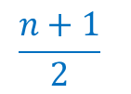
Multiple samplings to improve accuracy and reduce error probability
{ $5 , 23 , 69 , 73 , 110 , 129 , 135 , 154 , 195$}
$$k=9$$
Question: Which sampled ball is most likely to have label closest to $(n+1)/2$ ?
Question: What is the expected number of sampled balls with label $≥(n+1)/2$ ?
Answer: $k/2$ .
1
2
N
$$\frac{n+1}{2}$$
$$\frac{k}{2}$$

Slide 20
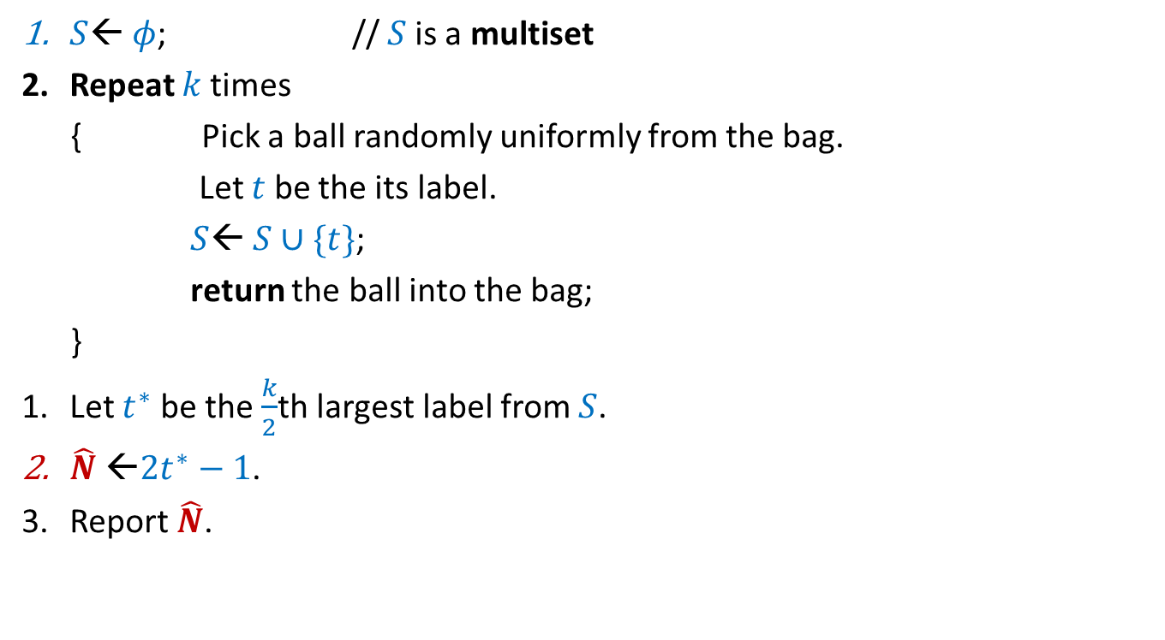
A better algorithm for estimating the number of balls:
$S$← $φ$; // $S$is a multiset
Repeat $k$times
{ Pick a ball randomly uniformly from the bag.
Let $t$ be the its label.
$S$← $S∪\{t\}$;
return the ball into the bag;
}
Let $t^{∗}$ be the $\frac{k}{2}$th largest label from $S$.
$\hat{N}$ ←$2t^{∗}−1$.
Report $\hat{N}$.

Slide 21
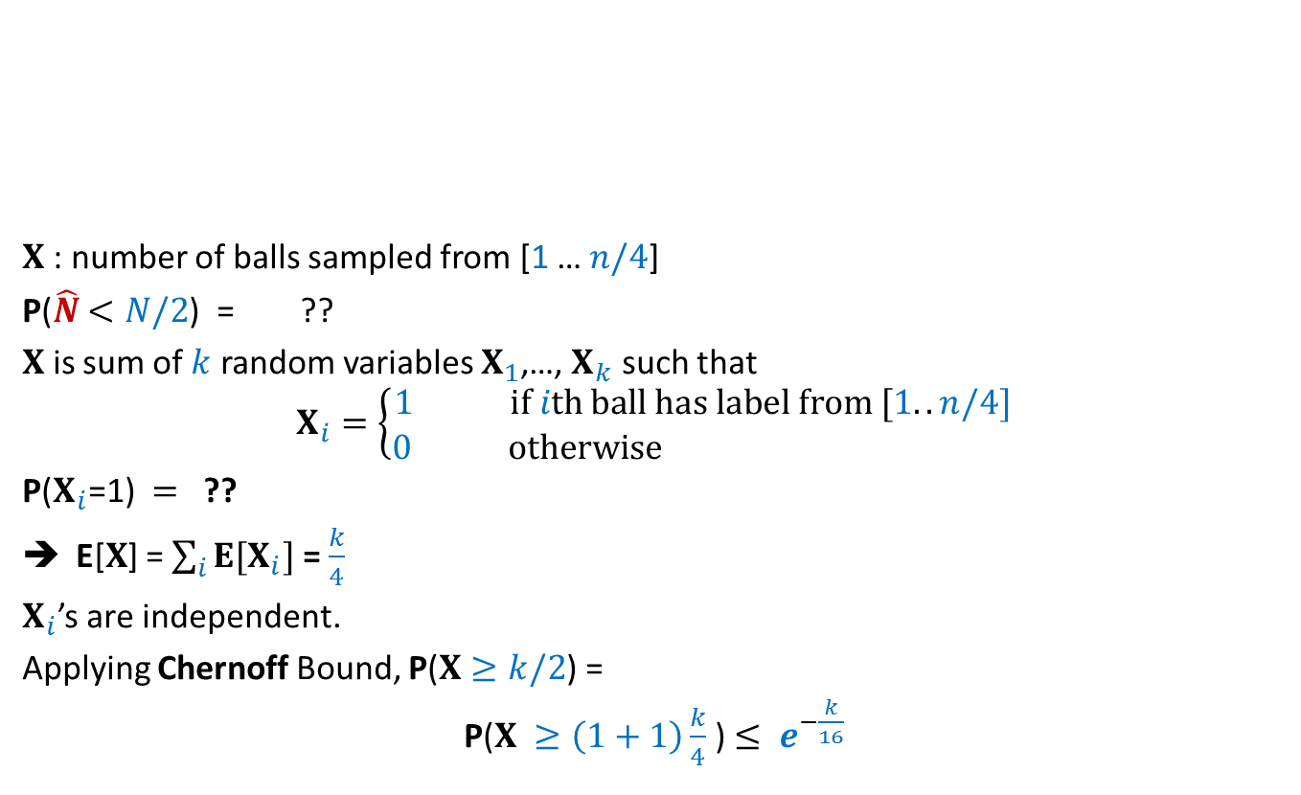




Question: What is P($\hat{N}$ $<N/2$) ?
$X$: number of balls sampled from [1 … $n/4$]
P($\hat{N}$ $<N/2$) = ??
$X$ is sum of $k$ random variables $X_{1}$,…, $X_{k}$ such that
$$X_{i}=\left\{\begin{aligned}1 if ith ball has label from [1..n/4] \\ 0 otherwise \end{aligned}\right.$$
P($X_{i}$=1) $=$ ??
E[$X$] = $\sum_{i}{E[X_{i}]}$ = $\frac{k}{4}$
$X_{i}$’s are independent.
Applying Chernoff Bound, P($X≥k/2$) =
P($X ≥\left(1+1\right)\frac{k}{4}$) $≤ e^{−\frac{k}{16}}$
1
2
$$N/4$$
N
P($X$>$k/2$)
$$¼$$

Slide 22

Final result
Theorem:
The randomized Monte Carlo performs $k$ sampling and reports a number $\hat{N}$
such that with probability at least $1−e^{−\frac{k}{16}}$ ,
$N/2≤$ $\hat{N}$ $≤2N$

Slide 23

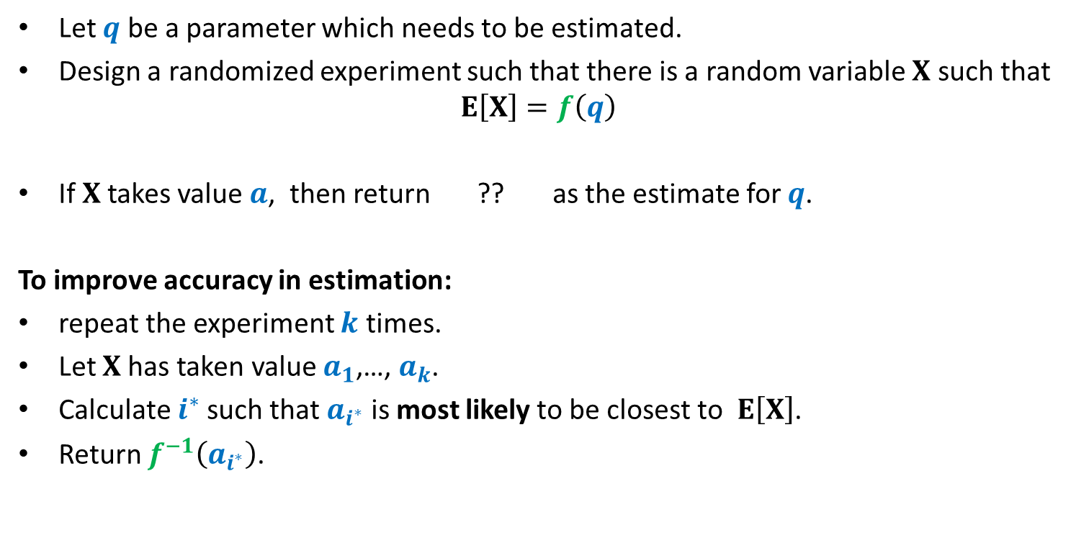
Randomized framework for estimating a parameter
Let $q$ be a parameter which needs to be estimated.
Design a randomized experiment such that there is a random variable $X$ such that
$$E\left[X\right]=f\left(q\right)$$
If $X$takes value $a$, then return ?? as the estimate for $q$.
To improve accuracy in estimation:
repeat the experiment $k$ times.
Let $X$has taken value $a_{1}$,…, $a_{k}$.
Calculate $i^{∗}$such that $a_{i^{∗}}$ is most likely to be closest to $E\left[X\right]$.
Return $f^{−1}\left(a_{i^{∗}}\right)$.
$$f^{−1}\left(a\right)$$

Slide 24
Estimating the size of Transitive Closure of a Directed Graph

Slide 25

$$x$$

Slide 26
$$x$$

Slide 27
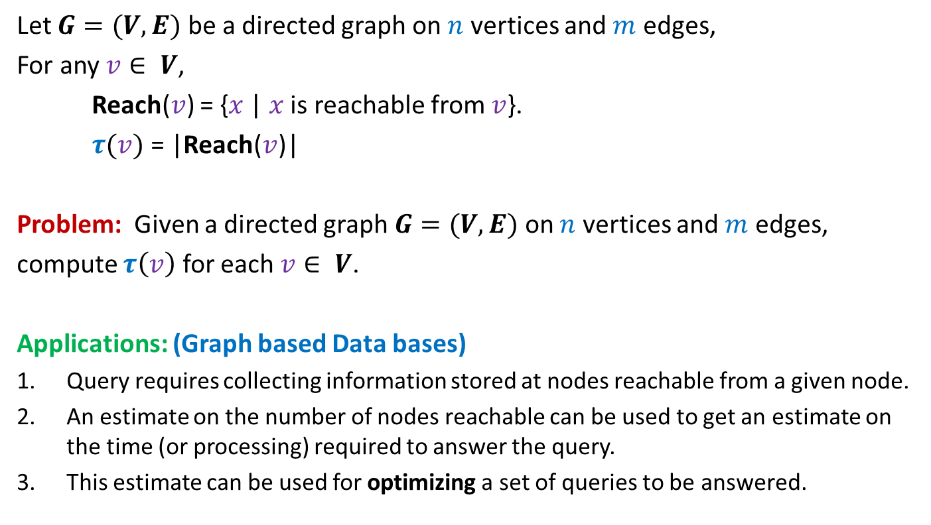
Estimating size of Transitive Closure of a Directed Graph
Let $G=(V,E)$ be a directed graph on $n$ vertices and $m$ edges,
For any $v∈ V$,
Reach($v$) = {$x$ | $x$ is reachable from $v$}.
$τ(v)$ = |Reach($v$)|
Problem: Given a directed graph $G=(V,E)$ on $n$ vertices and $m$ edges,
compute $τ\left(v\right)$ for each $v∈ V$.
Applications: (Graph based Data bases)
Query requires collecting information stored at nodes reachable from a given node.
An estimate on the number of nodes reachable can be used to get an estimate on the time (or processing) required to answer the query.
This estimate can be used for optimizing a set of queries to be answered.

Slide 28
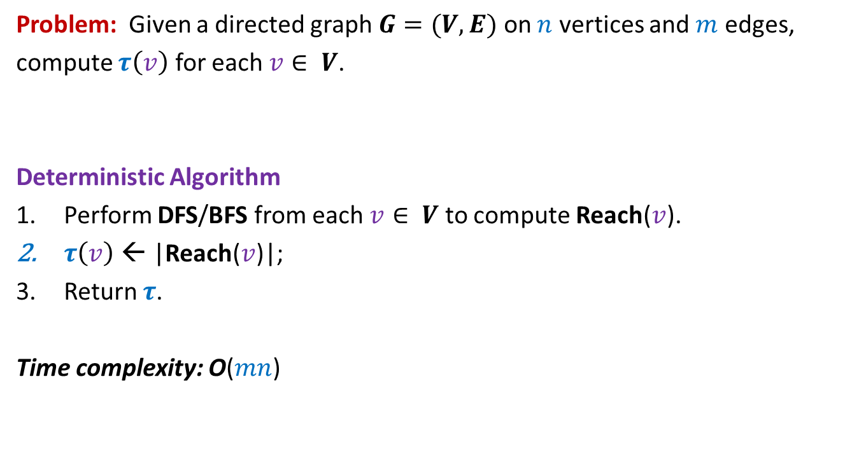
Estimating size of Transitive Closure of a Directed Graph
Problem: Given a directed graph $G=(V,E)$ on $n$ vertices and $m$ edges,
compute $τ\left(v\right)$ for each $v∈ V$.
Deterministic Algorithm
Perform DFS/BFS from each $v∈ V$ to compute Reach($v$).
$τ\left(v\right)$ ← |Reach($v$)|;
Return $τ$.
Time complexity: O($mn$)

Slide 29
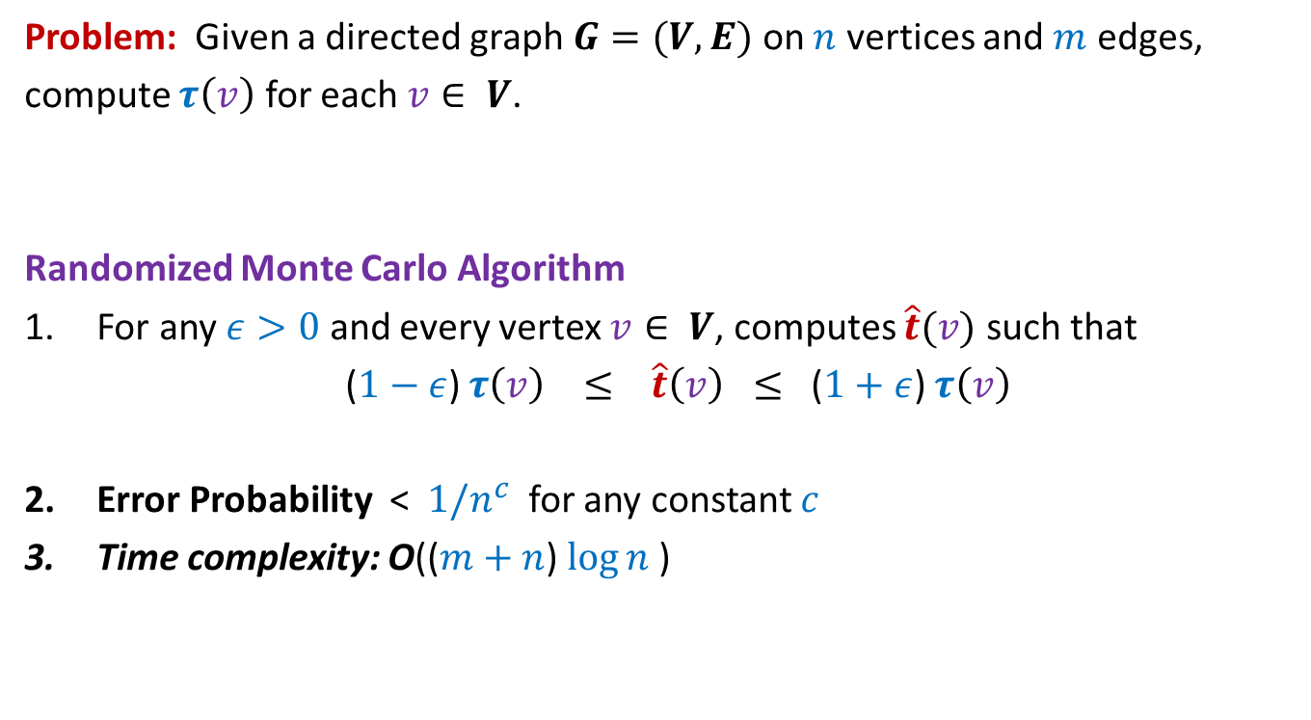
Estimating size of Transitive Closure of a Directed Graph
Problem: Given a directed graph $G=(V,E)$ on $n$ vertices and $m$ edges,
compute $τ\left(v\right)$ for each $v∈ V$.
Randomized Monte Carlo Algorithm
For any $ε>0$ and every vertex $v∈ V$, computes $\hat{t}(v)$ such that
($1−ε$) $τ\left(v\right) ≤ \hat{t}\left(v\right) ≤$ ($1+ε$) $τ\left(v\right)$
Error Probability < $1/n^{c}$ for any constant $c$
Time complexity: O(($m+n$) $\log{n}$)

Slide 30

Randomized Monte Carlo Algorithm for estimating the size of transitive closure of directed graph
Ingredients
A Deterministic O($m+n$) time algorithm for a problem “MinLabel”.
The inspirational probability problem we discussed today ☺.

Slide 31
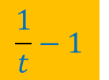
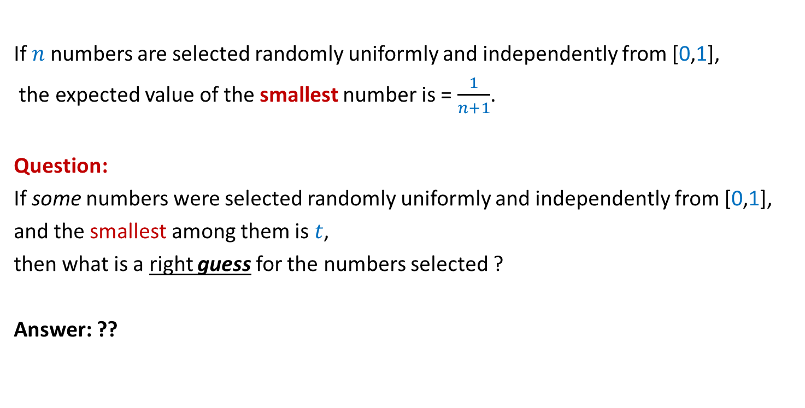
Inference from the inspirational problem
If $n$numbers are selected randomly uniformly and independently from [0,1],
the expected value of the smallest number is = $\frac{1}{n+1}$.
Question:
If some numbers were selected randomly uniformly and independently from [0,1],
and the smallest among them is $t$,
then what is a right guess for the numbers selected ?
Answer: ??
$$\frac{1}{t}−1$$
Spend some time now to design the algorithm based on this insight.

Slide 32
Randomized Monte Carlo algorithm
Estimating
the size of Transitive Closure
of a Directed Graph

Slide 33
$$x$$

Slide 34






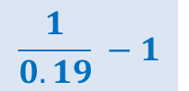
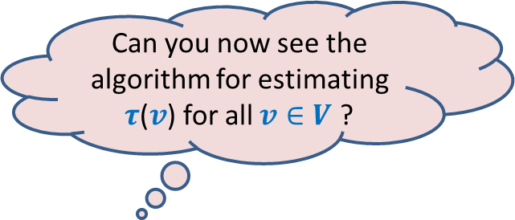
Suppose each vertex reachable from $x$ is assigned
a random no. uniformly distributed in the interval [$0,1$].
If we know the MinLabel($x$), how can we estimate $τ$($v$) ?
Can you now see the algorithm for estimating $τ$($v$) for all $v∈V$ ?
0.38
0.83
$$x$$
0.19
0.53
0.45
Estimate $\hat{τ}$($v$) :
$$\frac{1}{0.19} −1$$
$$=4.26$$
0.71
$$≈$$
$τ$($v$) :
$$=6$$

Slide 35
0.65
0.265
0.901
0.81
0.28
0.34
0.49
0.54
0.63
0.38
0.83
0.14
0.74
0.19
0.53
0.45
0.71

Slide 36
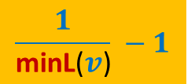

Estimating size of Transitive Closure of a Directed Graph
A simple algorithm:
Assign to each $v$ a no. $L$($v$) selected randomly uniformly and independently from [0,1].
Compute minL($v$) for each $v∈V$;
$\hat{τ}$($v$) ← ??
Return $\hat{τ}$.
$$\frac{1}{\text{minL}\text{(}v\text{)}} −1$$

Slide 37
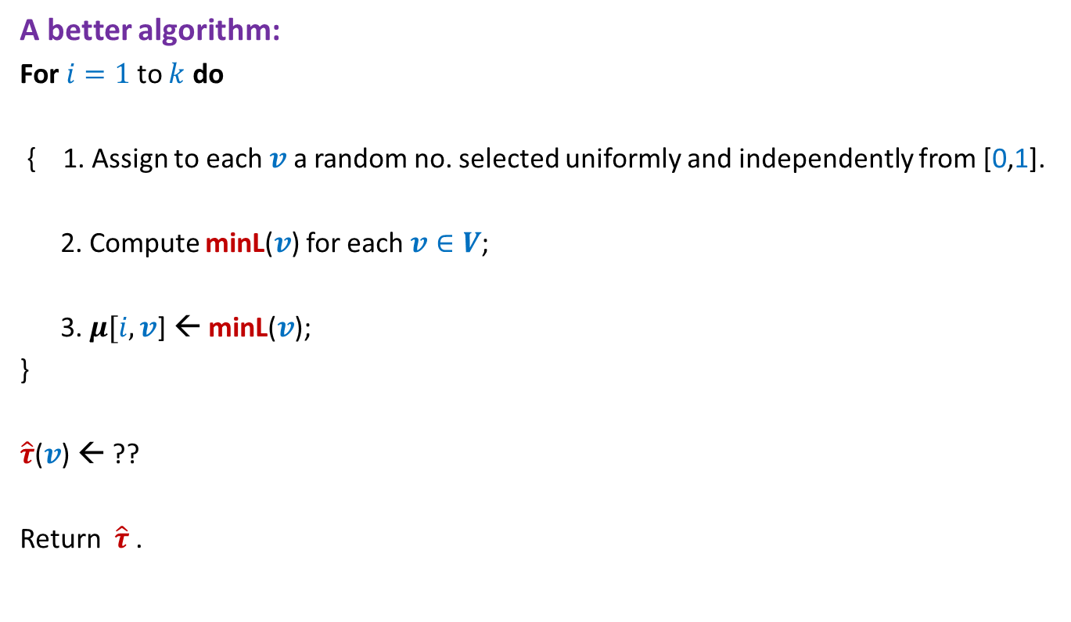
Estimating size of Transitive Closure of a Directed Graph
A better algorithm:
For $i=1$to $k$ do
{ 1. Assign to each $v$ a random no. selected uniformly and independently from [0,1].
2. Compute minL($v$) for each $v∈V$;
3. $μ[i,v$] ← minL($v$);
}
$\hat{τ}$($v$) ← ??
Return $\hat{τ}$.

Slide 38

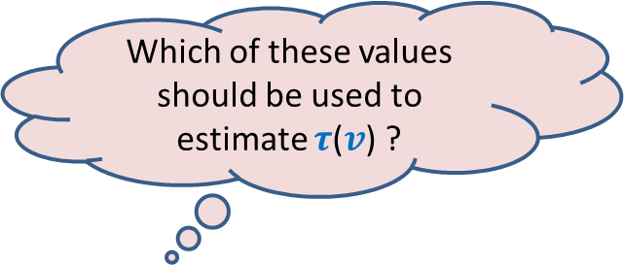

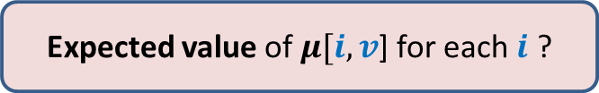

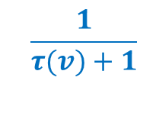
$\{μ[1,v$], $μ[2,v$], …, $μ[k,v]$}
Question 1: Which value among $\{μ[1,v$], …, $μ[k,v]$} is likely to be closest to $\frac{1}{τ(v)+1}$?
Question 2: How many of$\{μ[1,v$], …, $μ[k,v]$} are likely to have value $≥\frac{1}{τ(v)+1}$ ?
Question 3: What is the probability that $μ[i,v$] for any fixed $i$ is $≥\frac{1}{τ(v)+1}$
Answer: (Hint: for this to happen all vertices in Reach($v$) must get $L$() $≥\frac{1}{τ(v)+1}$)
This probability is = ${\left(1− \frac{1}{τ\left(v\right)+1}\right)}^{τ\left(v\right)}$≈ $\frac{1}{e}$
Which of these values should be used to estimate $τ$($v$) ?
$$\frac{k}{e}$$
Can you answer Question 2 now ?
0
1
$$\frac{1}{τ(v)+1}$$
Expected value of $μ[i,v$] for each $i$ ?

Slide 39
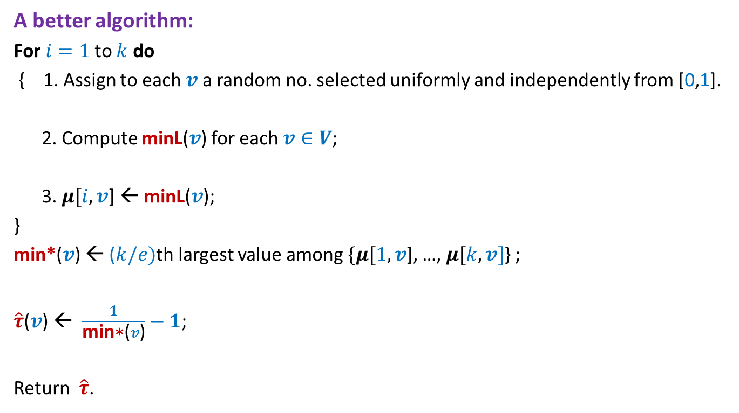
Estimating size of Transitive Closure of a Directed Graph
A better algorithm:
For $i=1$to $k$ do
{ 1. Assign to each $v$ a random no. selected uniformly and independently from [0,1].
2. Compute minL($v$) for each $v∈V$;
3. $μ[i,v$] ← minL($v$);
}
min*($v$) ← ($k/e)$th largest value among $\{μ[1,v$], …, $μ[k,v]$} ;
$\hat{τ}$($v$) ← $\frac{1}{\text{min}\text{∗}\text{(}v\text{)}}−1$;
Return $\hat{τ}$.

Slide 40
Homework
Use Chernoff bound to get a high probability bound on the error.
Hint:
Proceed along similar lines as in the case of estimating number of balls in a bag.
Make sincere attempts to do this homework. I shall discuss the same briefly in the beginning of the next class.

Slide 41
Students suggested many other ways to estimate the number of balls.
Using the average label of the sampled balls.
Using the maximum label of the sampled balls.
These are quite valid ways.
However, the aim is to get a guarantee on the accuracy of the estimation.
We could do it very easily for our method and it was quite generic as well.
You might like to study the following milestone paper on this.
Edith Cohen: Size-Estimation Framework with Applications to Transitive Closure and Reachability. J. Comput. Syst. Sci. 55(3): 441-453 (1997)

